Slide 1
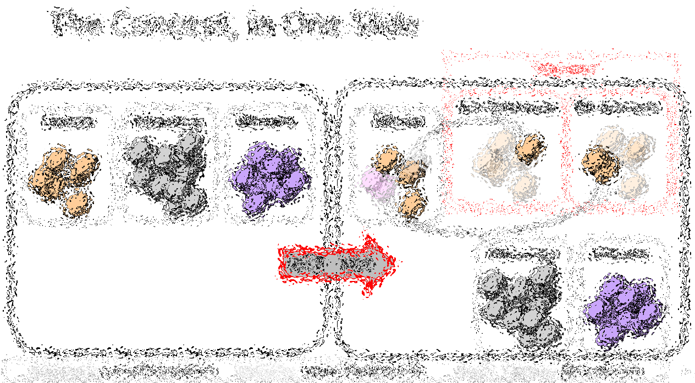

Bip300: Getting to 100% Bitcoin Dominance (and Beyond)
Paul Sztorc

Slide 2

The Concept, in One Slide
“Sidechains”
n
n
Bit-Ethereum
Bit-Monero
Bitcoin
Ethereum
Monero
Bitcoin
Bip300
Bip300
BIP 300
Ethereum
Monero

Slide 3

The Goal
Smart Contracts DeFi Turing Completeness Ring Signatures zk-Snarks Large Blocksizes
NFTs Oracles
Mimblewimble
…(etc)
Bitcoin does seem great… but can it do _______ ?
Actually we DON’T want Bitcoin to do ______ in the first place because it is actually a bad due to _______, as you can read ______. But if by ______ you really mean ______, then yes Bitcoin can do that! Eventually we are working on _____ which should be able to do ______ even better than ______ anyway but it is actually a good thing that the protocol is so difficult to upgrade beca …
Yes. See BIP 300.
Noob
Bitcoiner
Notes:
Two people conversing, speech bubbles
“But can Bitcoin do _____?”
“Yes, see Bip300”

Slide 4
Fringe Ideas
I can improve Bitcoin! It only needs my new idea: _______ !! When can you merge my code ??
You can’t just merge something into Bitcoin -- It affects everyone else’s nodes!! Besides, ______ has been proposed before and you need to read ______ so that you can learn why everyone hates it, especially our infallible _______ who would have done it by now if it were a good idea. ________ is a SCAM and you are trying to ATTACK BITCOIN!! Even if your idea was good it would probably take years to get consensus and get merged into …
Noob (and/or Fringe Genius)
Use BIP 300.
Good luck!!
Bitcoiner
Notes:
Picture of a stick figure with a top hat, with a thought bubble, thinking about: Blocksize, TC, KYC

Slide 5
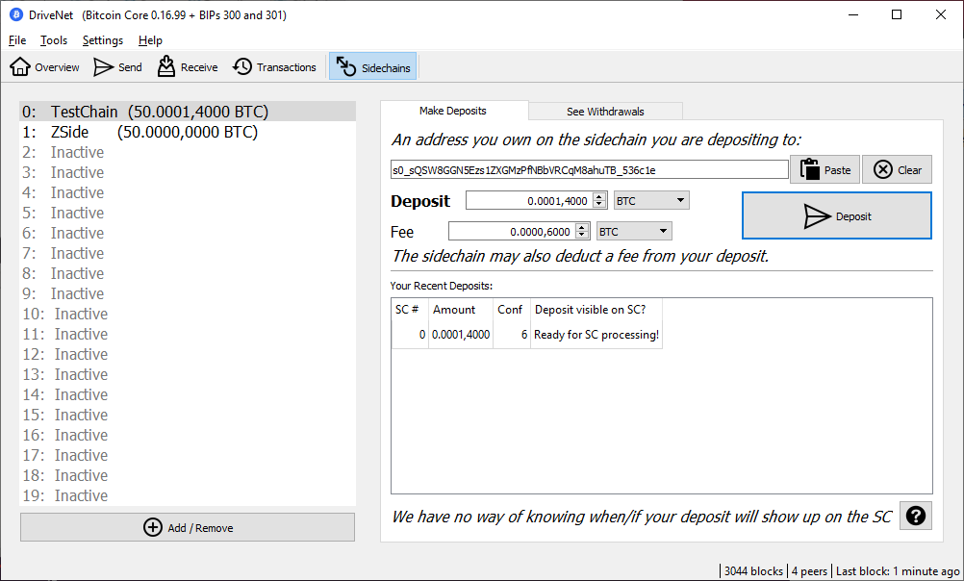
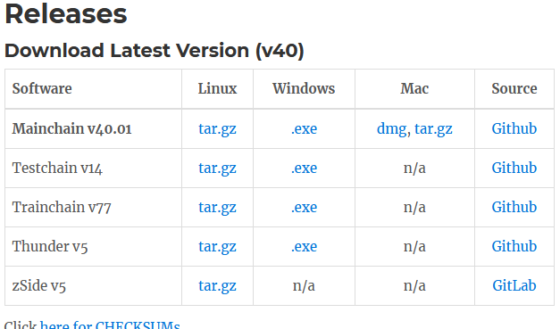
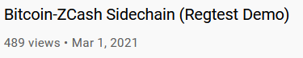
Three Aspects
Not Vaporware
Full Autonomy
Protect Base Layer
Improve Miner Incentives
Notes:
Also, has screenshots of Github/Gui/Youtube zcash Video

Slide 6

(#1) Full Autonomy
Bip300 Sidechains
zCash (Altcoin)
Bit-zCash
Bit-Monero
Lightning Apps
Strike
Zap
Metaphor
Bitcoin Core
Notes:
Should look like a screenshot from an iPhone, with lots of little apps called “zCash” “eth” “bch”, “…” but with a Big “Bip300” frame around it. Outside of the Bitcoin Frame is a Bitcoin Core app, and a “Lightning Frame” with LN Apps, and a word processor, web browser, calculator, etc
Have some ghosted-out coins, that move from Bitcoin Core app to the LN
At the bottom is a bullet point called “Cool Asymmetry”

Slide 7
(#1) Full Autonomy
Bip300 Sidechains
zCash (Altcoin)
Bit-zCash
Bit-Monero
Lightning Apps
Strike
Zap
Metaphor
Bitcoin Core
Notes:
Should look like a screenshot from an iPhone, with lots of little apps called “zCash” “eth” “bch”, “…” but with a Big “Bip300” frame around it. Outside of the Bitcoin Frame is a Bitcoin Core app, and a “Lightning Frame” with LN Apps, and a word processor, web browser, calculator, etc
Have some ghosted-out coins, that move from Bitcoin Core app to the LN
At the bottom is a bullet point called “Cool Asymmetry”

Slide 8
(#1) Full Autonomy
Bip300 Sidechains
zCash (Altcoin)
Bit-zCash
Bit-Monero
Lightning Apps
Strike
Zap
Metaphor
Bitcoin Core
Notes:
Should look like a screenshot from an iPhone, with lots of little apps called “zCash” “eth” “bch”, “…” but with a Big “Bip300” frame around it. Outside of the Bitcoin Frame is a Bitcoin Core app, and a “Lightning Frame” with LN Apps, and a word processor, web browser, calculator, etc
Have some ghosted-out coins, that move from Bitcoin Core app to the LN
At the bottom is a bullet point called “Cool Asymmetry”

Slide 9
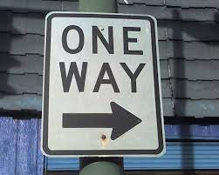
(#2) Base Layer is Safe
Bip300 Sidechains
Bit-zCash
Bit-Monero
Drama
Centralization
Reorgs
Bad Design
Base Layer
Bitcoin Core
Notes:
Two blockchains, (main and side), The sidechain has 3 month epochs with are defined by one hash.
There is an arrow from the hash to the layer1 coinbase txn, denoting the insertion

Slide 10
(#2) Base Layer is Safe
= Block Header
= List of transactions
December 2020
January 2021
February 2021
March 2021
April 2021
Base Layer (Bitcoin Core)
Notes:
Two blockchains, (main and side), The sidechain has 3 month epochs with are defined by one hash.
There is an arrow from the hash to the layer1 coinbase txn, denoting the insertion

Slide 11
(#2) Base Layer is Safe
= Block Header
= List of transactions
December 2020
January 2021
February 2021
March 2021
April 2021
Layer 2 (Bit-Monero)
Base Layer (Bitcoin Core)
Notes:
Two blockchains, (main and side), The sidechain has 3 month epochs with are defined by one hash.
There is an arrow from the hash to the layer1 coinbase txn, denoting the insertion

Slide 12
(#2) Base Layer is Safe
= Block Header
= List of transactions
December 2020
January 2021
February 2021
March 2021
April 2021
Layer 2 (Bit-Monero)
e320
81cd
3 Months = One 32-byte Hash
3 Months = One 32-byte Hash
e320b6c2fffc8d750423db8b1eb942ae710e951ed797f7affc8892b0f1fc122b
81cd02ab7e569e8bcd9317e2fe99f2de44d49ab2b8851ba4a308000000000000
Base Layer (Bitcoin Core)
e320 ... Pays Out
Notes:
Two blockchains, (main and side), The sidechain has 3 month epochs with are defined by one hash.
There is an arrow from the hash to the layer1 coinbase txn, denoting the insertion

Slide 13
Your Layer 1 Node Sees…
(#2) Base Layer is Safe
Base Layer (Bitcoin Core)
e320b6c2fffc8d750423db8b1eb942ae710e951ed797f7affc8892b0f1fc122b
e320 ... Pays Out
81cd02ab7e569e8bcd9317e2fe99f2de44d49ab2b8851ba4a308000000000000
Notes:
Two blockchains, (main and side), The sidechain has 3 month epochs with are defined by one hash.
There is an arrow from the hash to the layer1 coinbase txn, denoting the insertion

Slide 14
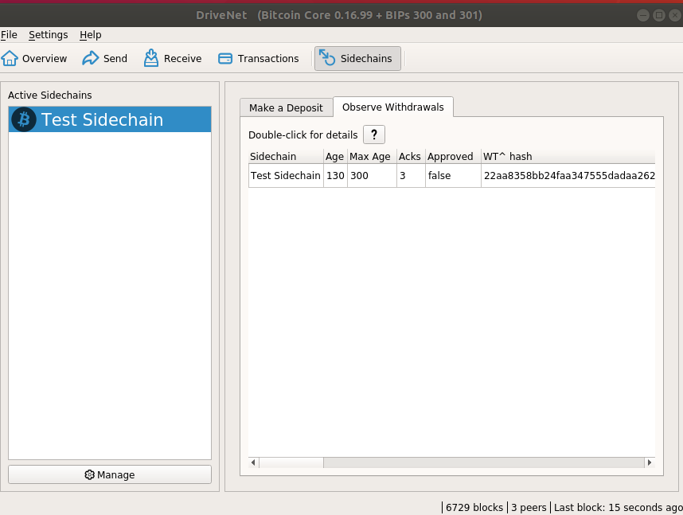
Your Layer 1 Node Sees…
(#2) Base Layer is Safe
Base Layer (Bitcoin Core)
e320b6c2fffc8d750423db8b1eb942ae710e951ed797f7affc8892b0f1fc122b
e320 ... Pays Out
81cd02ab7e569e8bcd9317e2fe99f2de44d49ab2b8851ba4a308000000000000
Notes:
Two blockchains, (main and side), The sidechain has 3 month epochs with are defined by one hash.
There is an arrow from the hash to the layer1 coinbase txn, denoting the insertion

Slide 15
Your Layer 1 Node Sees…
(#2) Base Layer is Safe
Software will look for a sidechain node, on your computer, (to ask it questions). But if it can’t find one it will report back nothing.
Hash we mentioned before
Base Layer (Bitcoin Core)
e320b6c2fffc8d750423db8b1eb942ae710e951ed797f7affc8892b0f1fc122b
e320 ... Pays Out
81cd02ab7e569e8bcd9317e2fe99f2de44d49ab2b8851ba4a308000000000000
Notes:
Two blockchains, (main and side), The sidechain has 3 month epochs with are defined by one hash.
There is an arrow from the hash to the layer1 coinbase txn, denoting the insertion

Slide 16
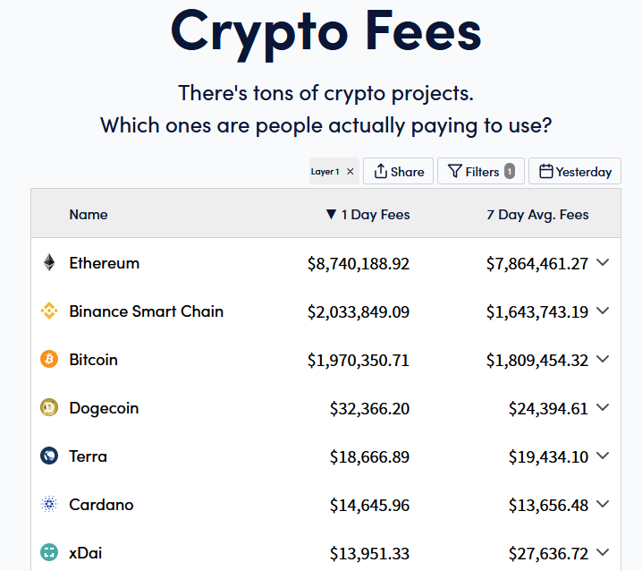
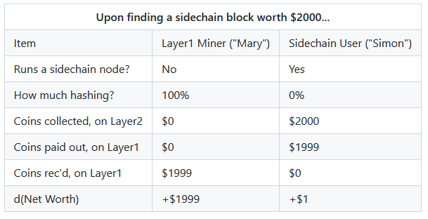
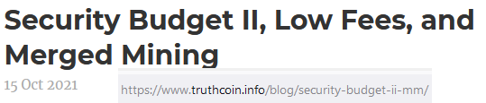
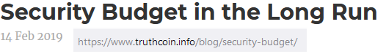
(#3) Improve Mining Incentives (Bip 301)
Get all of the fees, on all of the chains!
Miners can ignore Sidechain / Altcoin software.
Taken from https://cryptofees.info/ this morning.
June 4, 2021
Notes:
No temptation to run Altcoin Nodes
Miners collet fees from every txn, on every blockchain!
Miners don’t need to upgrade their software anymore.

Slide 17
(#3) Improve Mining Incentives (Bip 301)
Get all of the fees, on all of the chains!
Miners can ignore Sidechain / Altcoin software.
Taken from https://cryptofees.info/ this morning.
June 4, 2021
Notes:
No temptation to run Altcoin Nodes
Miners collet fees from every txn, on every blockchain!
Miners don’t need to upgrade their software anymore.

Slide 18
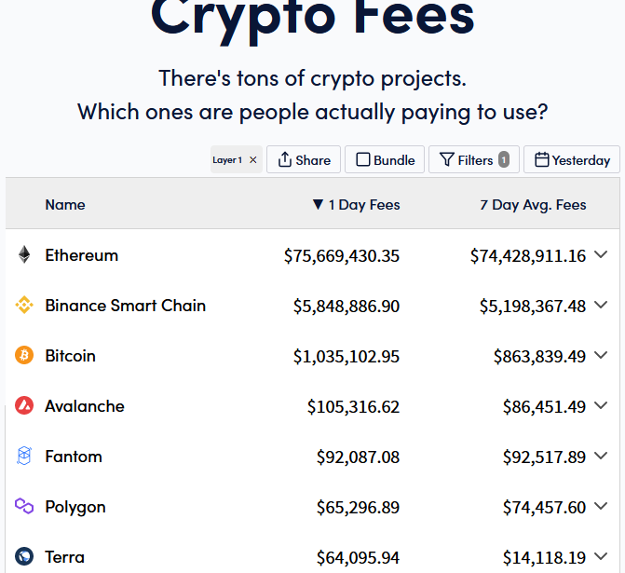
(#3) Improve Mining Incentives (Bip 301)
Get all of the fees, on all of the chains!
Miners can ignore Sidechain / Altcoin software.
+846%
+216%
-52%
Taken from https://cryptofees.info/ this morning.
November 4, 2021
June 4, 2021
Notes:
No temptation to run Altcoin Nodes
Miners collet fees from every txn, on every blockchain!
Miners don’t need to upgrade their software anymore.

Slide 19
Outline
Title / Summary (2)
Bip300 -- Goal, Three Aspects (16)
Outline (1) -- YOU ARE HERE
Altcoins We Should Copy (15)
The Supposed “Drawbacks” of Bip300 (2)
Ending (1)

Slide 20

What do we use BIP 300 for…?
(In other words: Which altcoins are worth copying?)
Art: “When I paint my masterpiece” – Nick Kenrick (?) - Creative commons license

Slide 21
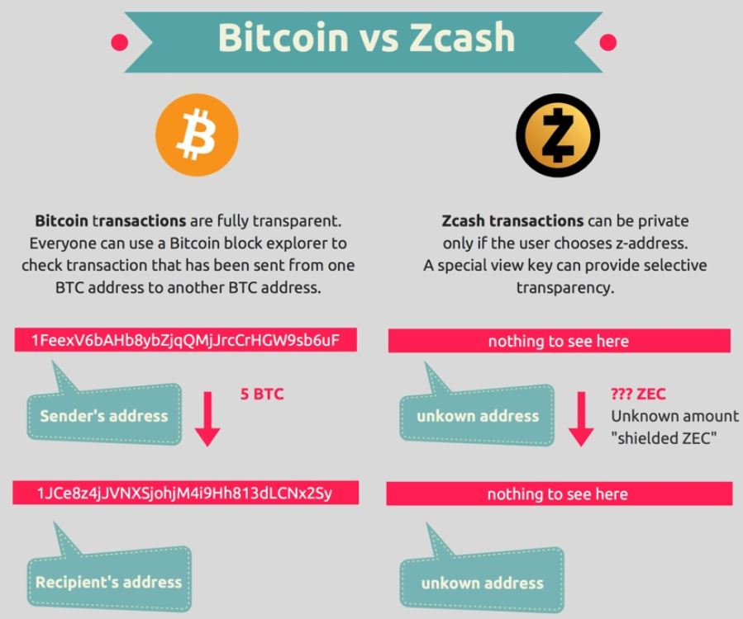
Altcoins we should copy (?): zCash
Image from blockchainhub.net : https://blockchainhub.net/blog/infographics/zcash-explained/

Slide 22
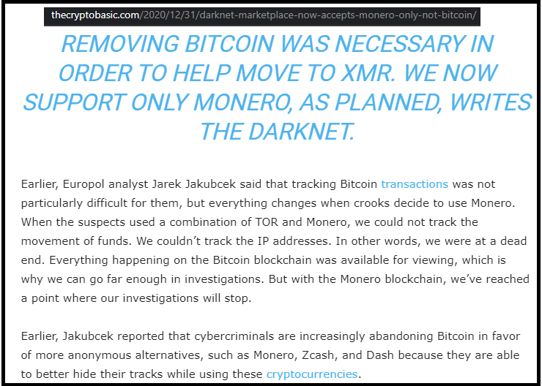
Losing Customers to Monero (?)
Lame!
“White House Market” Retired (not exit scam) on Oct 4, 2021 [last month]

Slide 23
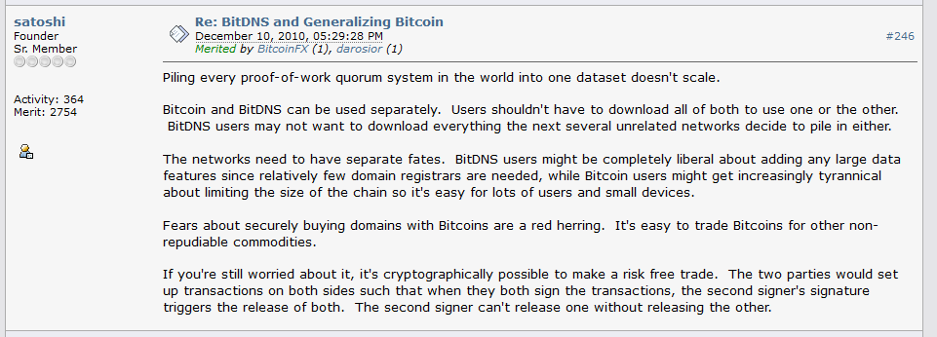
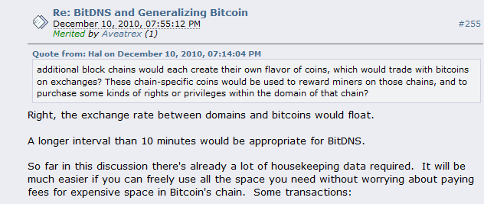
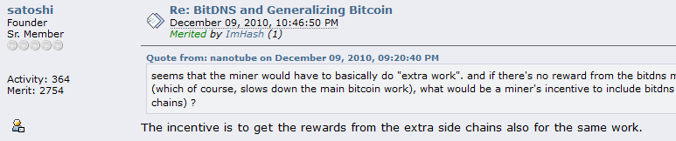
Altcoins we should copy (?): NameCoin
Fun facts -- in this thread, Satoshi: * Invents what is now known as Merged Mining. * Assumes that there will be many separate blockchains that pay different fees (as if this were non-controversial!).
* The term “side chain” is used numerous times!

Slide 24
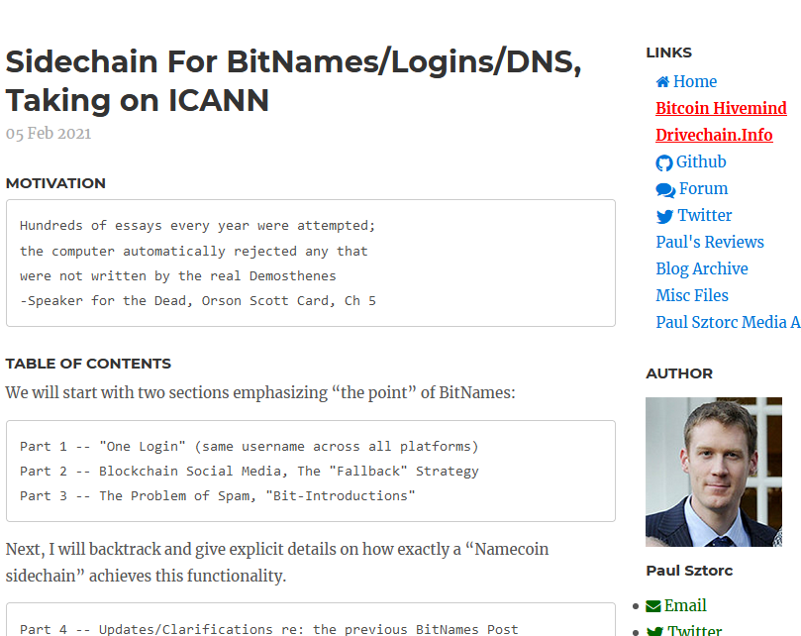
Altcoins we should copy (?): NameCoin
Screenshot #0 from www.truthcoin.info/blog/bitnames/

Slide 25
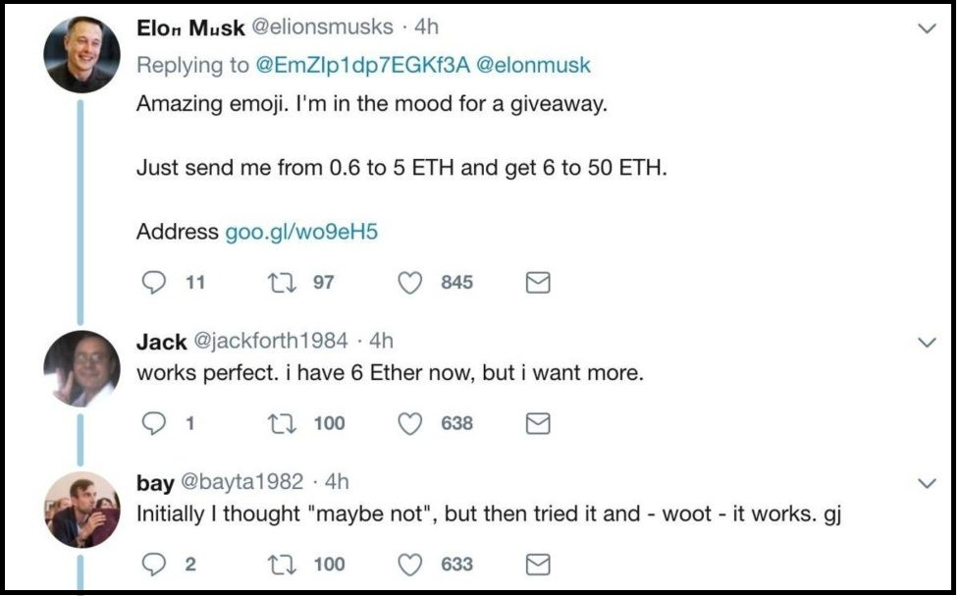
Screenshot #1 from www.truthcoin.info/blog/bitnames/
Altcoins we should copy (?): NameCoin

Slide 26
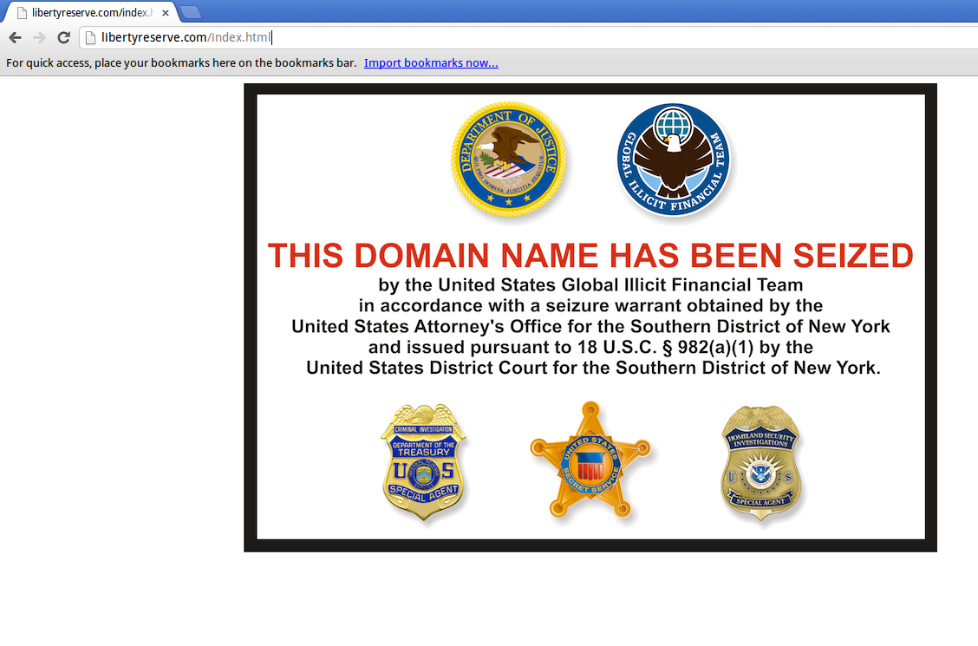
Screenshot #2 from www.truthcoin.info/blog/bitnames/
Altcoins we should copy (?): NameCoin

Slide 27
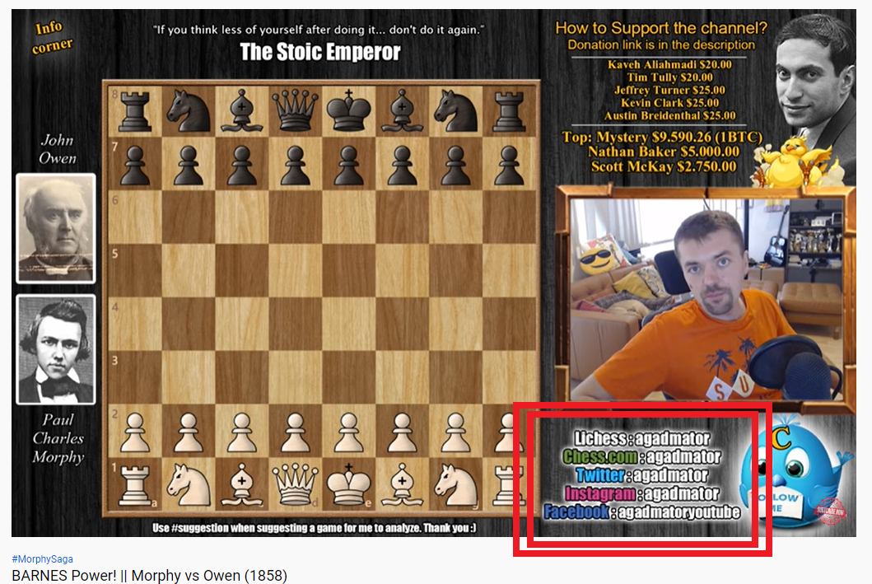
Screenshot #3 from www.truthcoin.info/blog/bitnames/
Altcoins we should copy (?): NameCoin

Slide 28
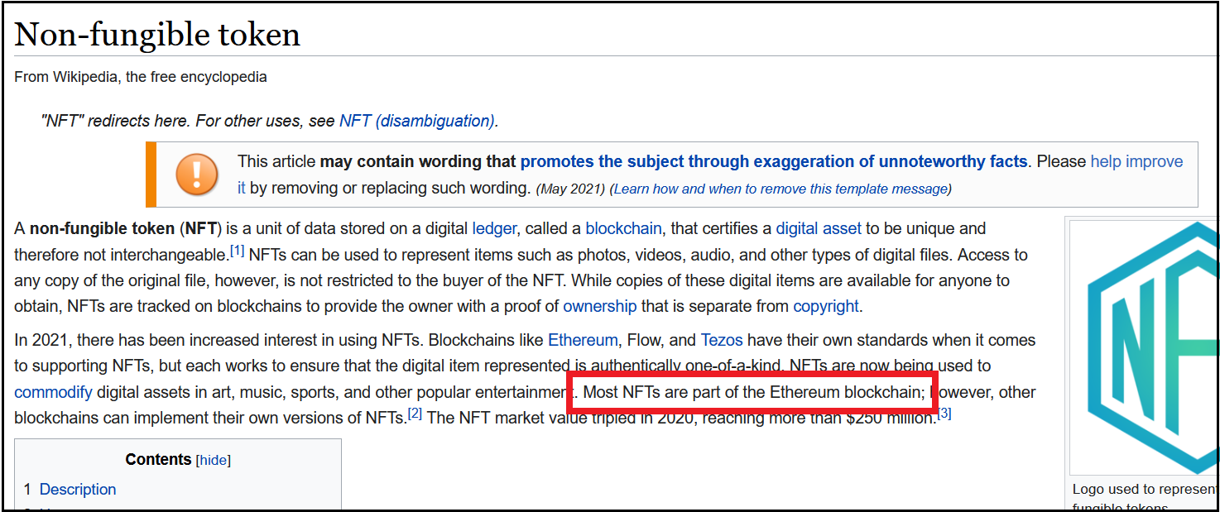
Altcoins we should copy (?): XCP / BitAssets / ERC20
Screenshots NFT craze, Cap table, Outstanding Bonds
So lame!!

Slide 29
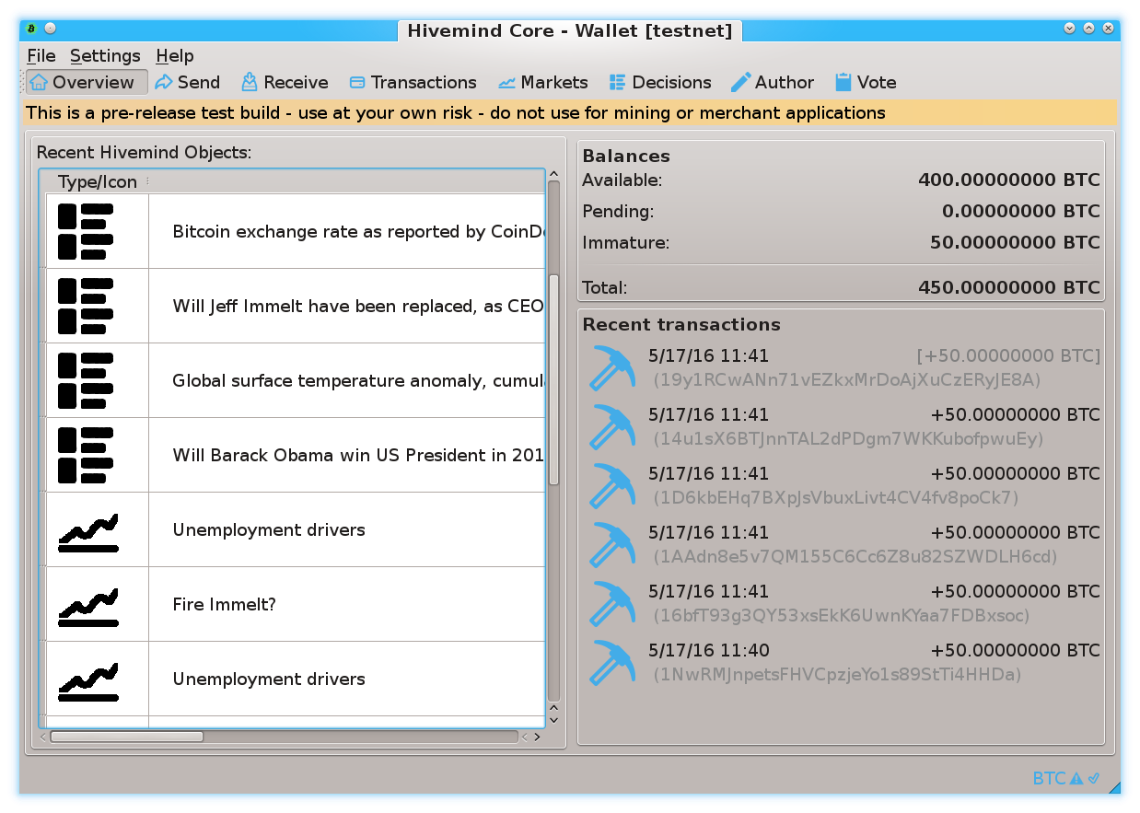
Prediction Markets
Screenshots from my own BTC sidechain project
www.BitcoinHivemind.com

Slide 30
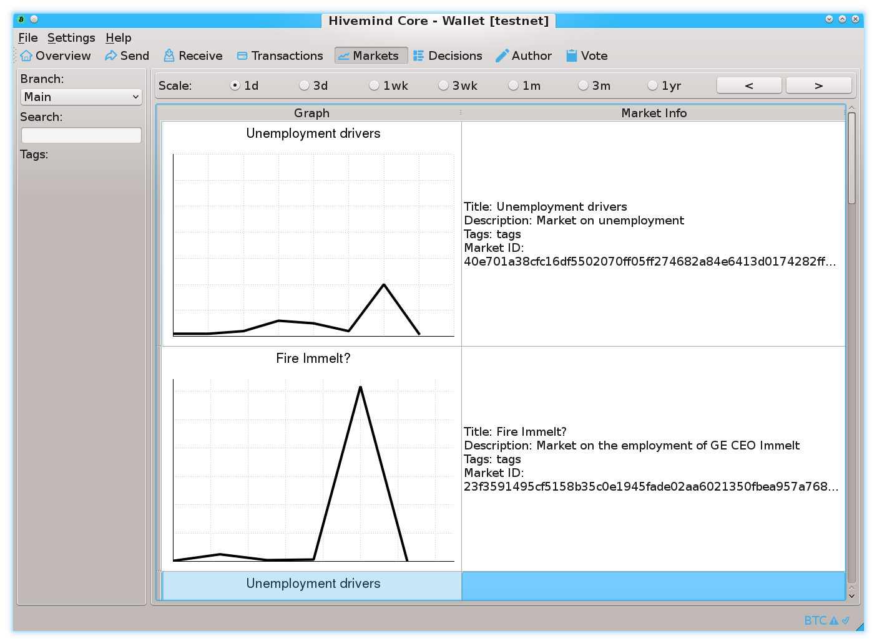
Prediction Markets
Screenshots from my own BTC sidechain project
www.BitcoinHivemind.com

Slide 31
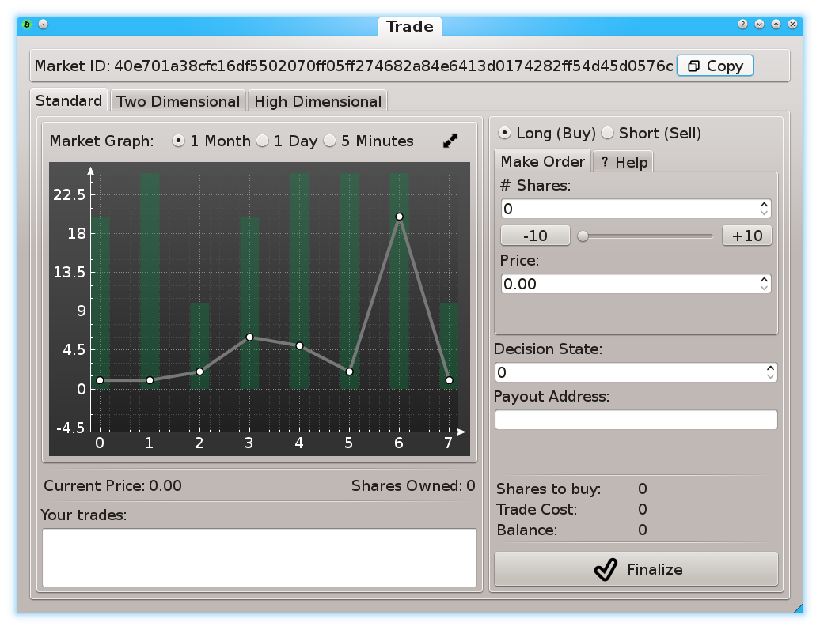
Prediction Markets
Screenshots from my own BTC sidechain project
www.BitcoinHivemind.com

Slide 32
Prediction Markets
Screenshots from my own BTC sidechain project
www.BitcoinHivemind.com
Key Idea: “Futarchy” -- futures markets for how well certain leaders would perform, if they were in charge.

Slide 33

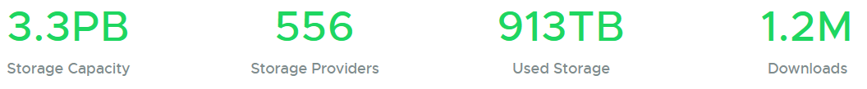
Altcoins we should copy (?): Sia
P2P Cloud Storage – Managed via Blockchain
Running for 5 years
No files ever lost?
$1-2 per TB/month (vs $23 on Amazon S3)
https://sia.tech
June 4

Slide 34
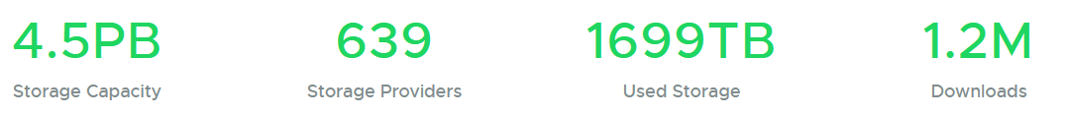
Altcoins we should copy (?): Sia
P2P Cloud Storage – Managed via Blockchain
Running for 5 years
No files ever lost?
$1-2 per TB/month (vs $23 on Amazon S3)
https://sia.tech
June 4
Nov 4 (Yesterday)
+36%
+15%
+86%
+0%

Slide 35

Finally: How Bip300 Improves Layer1
Never Change Layer 1 Again – “Protocol Ossification”
No “drama”.
No “mob rule”.
Shrink Layer1 Blocksize.
Improves Decentralization.
Protects your node.
“Frozen Bitcoin” - Marco Verch , Creative Commons License

Slide 36
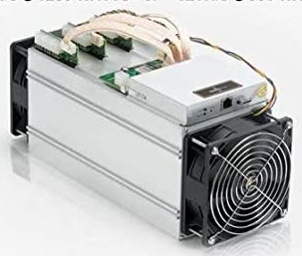
Two Supposed Drawbacks
(#1) Miners-Can-Steal from Bip300 Scripts (and this is bad)
Hashrate
fixed
cost
0%
100%
(#2) Merged-Mining is a Side-Hustle (and those are bad)
eb942ae710e951ed797e320b6c2fffc8d750423db8b1f2b0f1fc122b7affc889
eb94 ... Pays Out
e320b6c2fffc8d750423db8b1eb942ae710e951ed797f7affc8892b0f1fc122b
Notes:
It kind of implies that everything you would do, to help miners, is actually bad.

Slide 37
(#1) Miners-Can-Steal from Bip300 Scripts (and this is bad) | (#2) Merged-Mining is a Side-Hustle (and those are always bad)
The free market allows entrepreneurs to go bankrupt – this is an essential part of creativity. True: not every SC will succeed. But those few that do, will pay fees to miners and boost BTC’s appeal (since BTC can now easily do everything). The failures will serve as a warning to lazy or incompetent developers. | The fixed cost in question… …is zero under BMM. …was already microscopic, vs other miner fixed costs. …must always be small enough for non-mining nodes to exist (since their revenue is the smallest of all, $0.)
Bip300 has multiple safeguards in place to make “stealing” difficult. Stealing requires 3-6 months of openly dishonest mining activity. Humans can audit theft, by checking just 32 bytes. | Mining is a complex task involving many “sub-tasks” (getting cheap power / sourcing good ASICs / etc). Each has its own incentives, innovation, and fixed costs. No stopping those.
Miners “can” steal from Lightning Network (by broadcasting old state + censoring Justice Txns), but this criterion is never held against LN. | Bizarre implications: if BitFury sold t-shirts on the side, for profit, then t-shirts = bad for BTC. If Saylor altruistically paid miners $0.10 per year, then MS = bad for Bitcoin.
The user is sovereign. Users are allowed to sell their BTC for USD; or use BTC to buy “bad” products (ie “drugs”). Or invest in Alts / scams. Bip300 allows users to spend BTC to a script. | MM is the opposite of bad – it is good and necessary. MM alone can boost BTC’s fee revenues by 10,000x or more. Without MM, long run hashrate may be too low.
This supposed “flaw” is actually a pro, as it gives miners motive and opportunity to destroy “parasite sidechains” (SC which antagonize other SCs). I am not aware of any other way of efficiently accomplishing this. And I believe it is prerequisite for high-quality smart contracts. | What is probably happening is that people are confusing node costs with mining costs. Node costs *must* be low, for decentralization. But mining costs have no such requirement. In fact, if we wanted mining costs to be low we could remove the upward difficulty adjustments.
The whole point of SCs is that Layer1 nodes ignore them. With federations, you trust a fixed committee of law-abiding people. With BIp300 you trust a decentralized P2P process. | MM is already unblockable. Satoshi invented MM in 2010, and envisioned many independent MM chains. We have been MM since 2011, with no end in sight.
Notes:
It kind of implies that everything you would do, to help miners, is actually bad.

Slide 38
(#1) Miners-Can-Steal from Bip300 Scripts (and this is bad) | (#2) Merged-Mining is a Side-Hustle (and those are always bad)
The free market allows entrepreneurs to go bankrupt – this is an essential part of creativity. True: not every SC will succeed. But those few that do, will pay fees to miners and boost BTC’s appeal (since BTC can now easily do everything). The failures will serve as a warning to lazy or incompetent developers. | The fixed cost in question… …is zero under BMM. …was already microscopic, vs other miner fixed costs. …must always be small enough for non-mining nodes to exist (since their revenue is the smallest of all, $0.)
Bip300 has multiple safeguards in place to make “stealing” difficult. Stealing requires 3-6 months of openly dishonest mining activity. Humans can audit theft, by checking just 32 bytes. | Mining is a complex task involving many “sub-tasks” (getting cheap power / sourcing good ASICs / etc). Each has its own incentives, innovation, and fixed costs. No stopping those.
Miners “can” steal from Lightning Network (by broadcasting old state + censoring Justice Txns), but this criterion is never held against LN. | Bizarre implications: if BitFury sold t-shirts on the side, for profit, then t-shirts = bad for BTC. If Saylor altruistically paid miners $0.10 per year, then MS = bad for Bitcoin.
The user is sovereign. Users are allowed to sell their BTC for USD; or use BTC to buy “bad” products (ie “drugs”). Or invest in Alts / scams. Bip300 allows users to spend BTC to a script. | MM is the opposite of bad – it is good and necessary. MM alone can boost BTC’s fee revenues by 10,000x or more. Without MM, long run hashrate may be too low.
This supposed “flaw” is actually a pro, as it gives miners motive and opportunity to destroy “parasite sidechains” (SC which antagonize other SCs). I am not aware of any other way of efficiently accomplishing this. And I believe it is prerequisite for high-quality smart contracts. | What is probably happening is that people are confusing node costs with mining costs. Node costs *must* be low, for decentralization. But mining costs have no such requirement. In fact, if we wanted mining costs to be low we could remove the upward difficulty adjustments.
The whole point of SCs is that Layer1 nodes ignore them. With federations, you trust a fixed committee of law-abiding people. With BIp300 you trust a decentralized P2P process. | MM is already unblockable. Satoshi invented MM in 2010, and envisioned many independent MM chains. We have been MM since 2011, with no end in sight.
c
Notes:
It kind of implies that everything you would do, to help miners, is actually bad.

Slide 39
(#1) Miners-Can-Steal from Bip300 Scripts (and this is bad) | (#2) Merged-Mining is a Side-Hustle (and those are always bad)
The free market allows entrepreneurs to go bankrupt – this is an essential part of creativity. True: not every SC will succeed. But those few that do, will pay fees to miners and boost BTC’s appeal (since BTC can now easily do everything). The failures will serve as a warning to lazy or incompetent developers. | The fixed cost in question… …is zero under BMM. …was already microscopic, vs other miner fixed costs. …must always be small enough for non-mining nodes to exist (since their revenue is the smallest of all, $0.)
Bip300 has multiple safeguards in place to make “stealing” difficult. Stealing requires 3-6 months of openly dishonest mining activity. Humans can audit theft, by checking just 32 bytes. | Mining is a complex task involving many “sub-tasks” (getting cheap power / sourcing good ASICs / etc). Each has its own incentives, innovation, and fixed costs. No stopping those.
Miners “can” steal from Lightning Network (by broadcasting old state + censoring Justice Txns), but this criterion is never held against LN. | Bizarre implications: if BitFury sold t-shirts on the side, for profit, then t-shirts = bad for BTC. If Saylor altruistically paid miners $0.10 per year, then MS = bad for Bitcoin.
The user is sovereign. Users are allowed to sell their BTC for USD; or use BTC to buy “bad” products (ie “drugs”). Or invest in Alts / scams. Bip300 allows users to spend BTC to a script. | MM is the opposite of bad – it is good and necessary. MM alone can boost BTC’s fee revenues by 10,000x or more. Without MM, long run hashrate may be too low.
This supposed “flaw” is actually a pro, as it gives miners motive and opportunity to destroy “parasite sidechains” (SC which antagonize other SCs). I am not aware of any other way of efficiently accomplishing this. And I believe it is prerequisite for high-quality smart contracts. | What is probably happening is that people are confusing node costs with mining costs. Node costs *must* be low, for decentralization. But mining costs have no such requirement. In fact, if we wanted mining costs to be low we could remove the upward difficulty adjustments.
The whole point of SCs is that Layer1 nodes ignore them. With federations, you trust a fixed committee of law-abiding people. With BIp300 you trust a decentralized P2P process. | MM is already unblockable. Satoshi invented MM in 2010, and envisioned many independent MM chains. We have been MM since 2011, with no end in sight.
Notes:
It kind of implies that everything you would do, to help miners, is actually bad.

Slide 40
(#1) Miners-Can-Steal from Bip300 Scripts (and this is bad) | (#2) Merged-Mining is a Side-Hustle (and those are always bad)
The free market allows entrepreneurs to go bankrupt – this is an essential part of creativity. True: not every SC will succeed. But those few that do, will pay fees to miners and boost BTC’s appeal (since BTC can now easily do everything). The failures will serve as a warning to lazy or incompetent developers. | The fixed cost in question… …is zero under BMM. …was already microscopic, vs other miner fixed costs. …must always be small enough for non-mining nodes to exist (since their revenue is the smallest of all, $0.)
Bip300 has multiple safeguards in place to make “stealing” difficult. Stealing requires 3-6 months of openly dishonest mining activity. Humans can audit theft, by checking just 32 bytes. | Mining is a complex task involving many “sub-tasks” (getting cheap power / sourcing good ASICs / etc). Each has its own incentives, innovation, and fixed costs. No stopping those.
Miners “can” steal from Lightning Network (by broadcasting old state + censoring Justice Txns), but this criterion is never held against LN. | Bizarre implications: if BitFury sold t-shirts on the side, for profit, then t-shirts = bad for BTC. If Saylor altruistically paid miners $0.10 per year, then MS = bad for Bitcoin.
The user is sovereign. Users are allowed to sell their BTC for USD; or use BTC to buy “bad” products (ie “drugs”). Or invest in Alts / scams. Bip300 allows users to spend BTC to a script. | MM is the opposite of bad – it is good and necessary. MM alone can boost BTC’s fee revenues by 10,000x or more. Without MM, long run hashrate may be too low.
This supposed “flaw” is actually a pro, as it gives miners motive and opportunity to destroy “parasite sidechains” (SC which antagonize other SCs). I am not aware of any other way of efficiently accomplishing this. And I believe it is prerequisite for high-quality smart contracts. | What is probably happening is that people are confusing node costs with mining costs. Node costs *must* be low, for decentralization. But mining costs have no such requirement. In fact, if we wanted mining costs to be low we could remove the upward difficulty adjustments.
The whole point of SCs is that Layer1 nodes ignore them. With federations, you trust a fixed committee of law-abiding people. With BIp300 you trust a decentralized P2P process. | MM is already unblockable. Satoshi invented MM in 2010, and envisioned many independent MM chains. We have been MM since 2011, with no end in sight.
Notes:
It kind of implies that everything you would do, to help miners, is actually bad.

Slide 41
Future of Bip300 – Depends on You!
Learn !
Download the software
Read drivechain.info
Talk
Soft forks need consensus
Invite on podcasts/whatever
View Altcoins Differently
drivechain.info/releases/
Drivechain = Bip 300+301
Talk
Learn

Slide 42
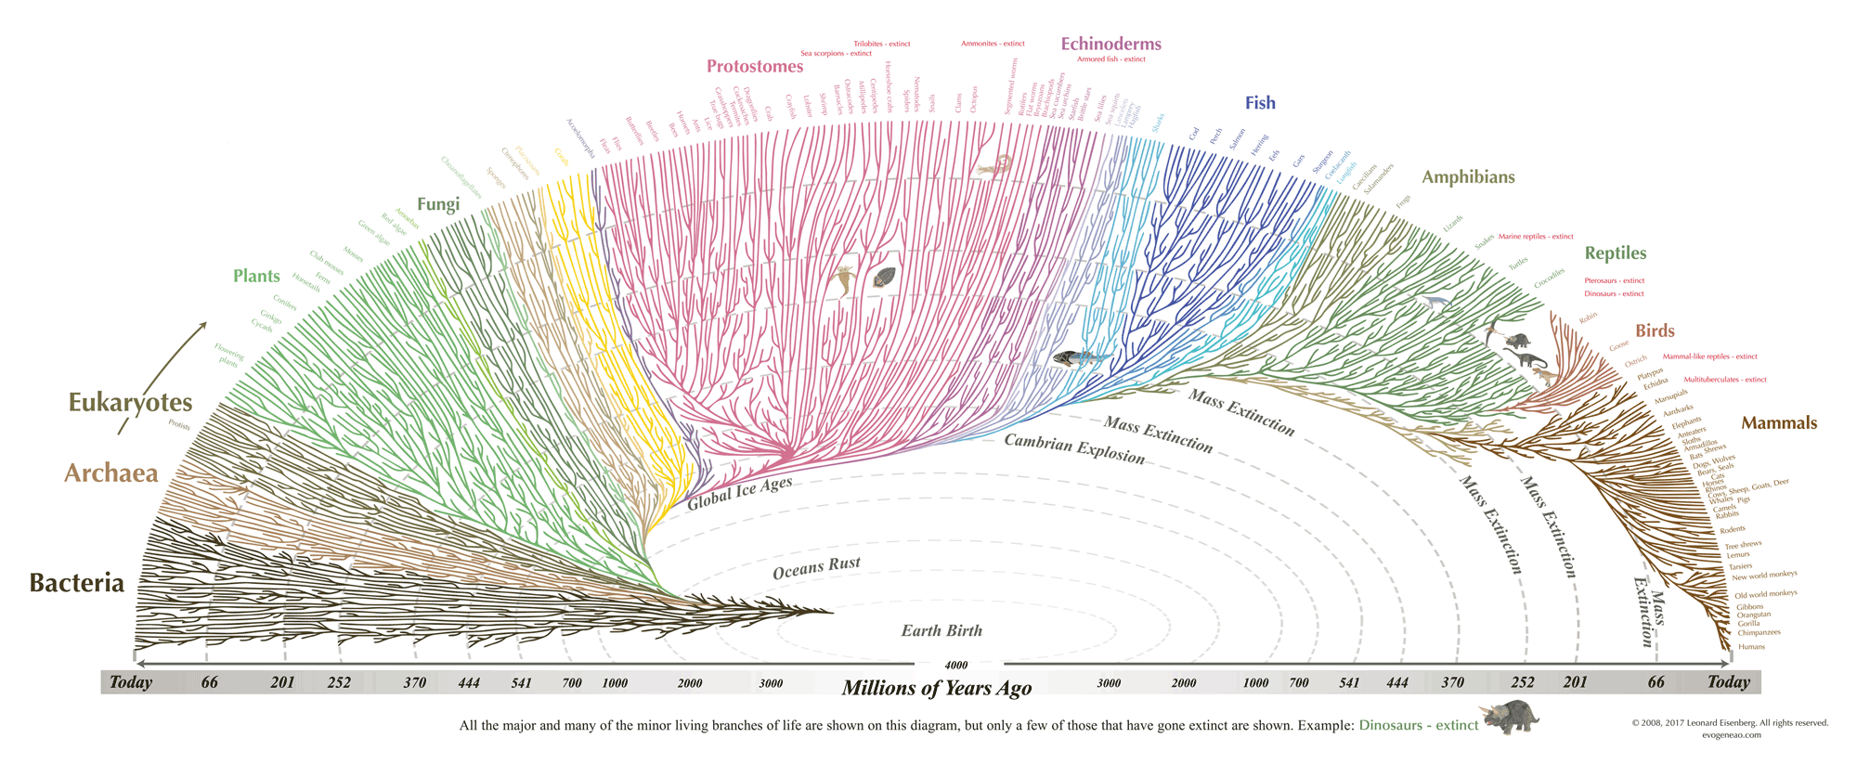
Thank You for Your Attention! (Find me and talk to me!)
Notes:
This is the tree of life. It represents creativity. Most new creations fail, but creativity itself is a good thing. We can either have it withing Bitcoin, making us stronger, or we have it outside of Bitcoin, competition with Bitcoin and making us weaker.

Slide 43
Thank You for Your Attention! (Find me and talk to me!)

Slide 44
Then, and Now
Total “Crypto” Activity
Time
2011
2014
2019
2021

